Slide 1


Outline
Brief introduction to EFFORT
Update on EFFORT Trial in the UK
Barriers to Site engagement
What can we do to increase the number of patients enrolled?
What can we do to increase the ‘separation’ between the 2 groups?
Time for Q&A

Slide 2

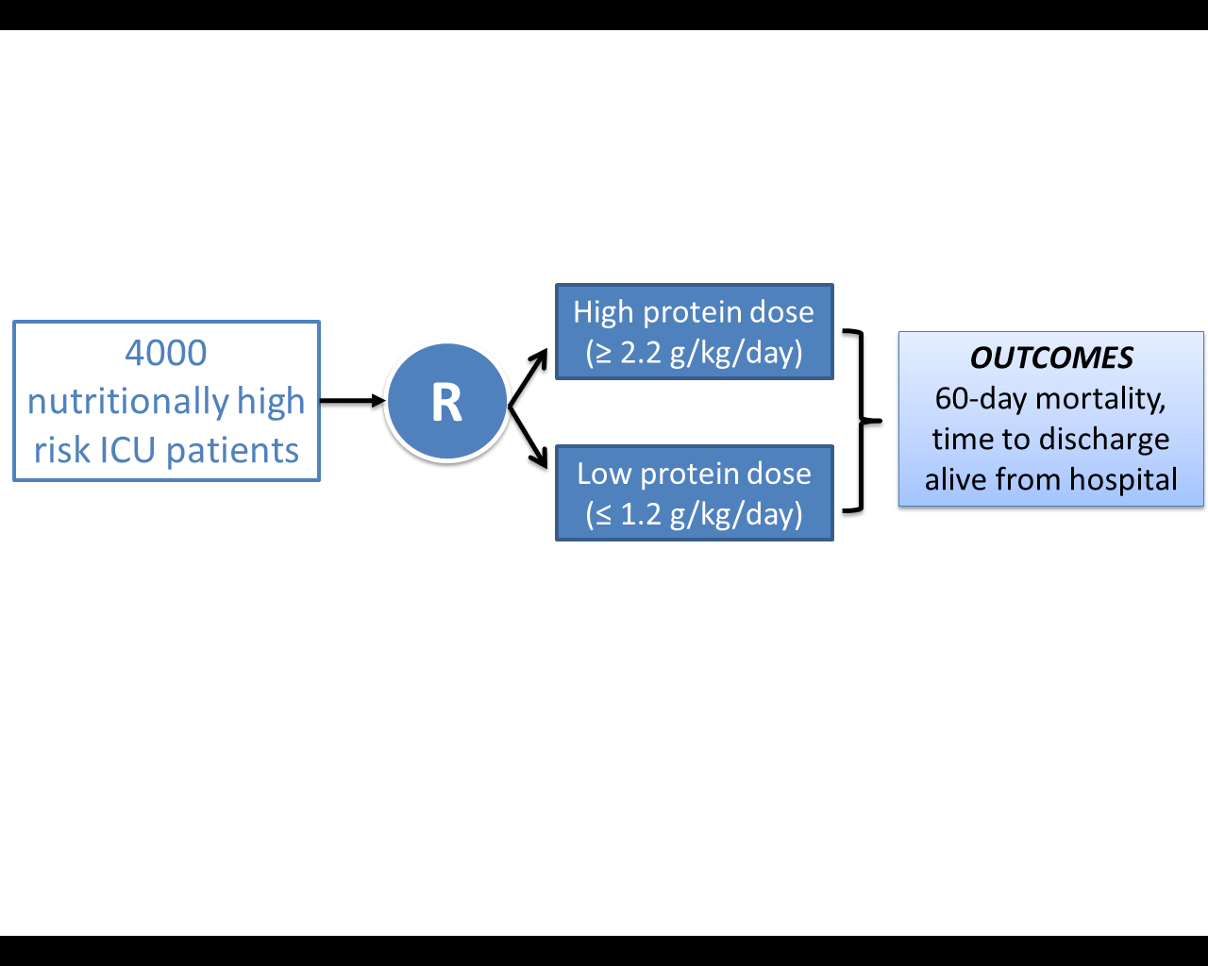
The Effect of Higher Protein Dosing
in Critically Ill Patients:
The EFFORT Trial
Higher protein
dose
( > 2.2 g/kg/d)
4000
Nutritionally high
risk ICU patients
Target >2.2 gram/kg/day
OUTCOMES
60-day mortality,
time to discharge
alive from hospital
R
Primary Outcome
4000 ICU patients
R
Stratified by:
Site
BMI
Med vs Surg
Usual protein
dose
( < 1.2 g/kg/d)
Fed enterally
60 day
mortality
Target <1.2 gram/kg/day
A multicentre, pragmatic, volunteer-driven, registry-based, randomized, clinical trial.
Notes:
.

Slide 3


Intensive Care Medicine 2017

Slide 4
Registry-based Randomized Clinical Trials (RRCT)
A possibility?
Recent experience with large scale, multi-center, observational studies conducted by volunteers in hundreds of ICUs around the world opens the possibility of using the same International Nutrition Survey (INS) infrastructure to support large scale, randomized trials.
The creation of registry-based, volunteer supported, large-scale, randomized clinical trials related to critical care clinical nutrition
37 ICUs from UK participated in past INS

Slide 5
Value of Bench-marked Site Reports
Recommendations: Based on 8 level 2 studies, we recommend early enteral nutrition (within 24-48 hrs following resuscitation) in critically ill patients.
Early vs Delayed Nutrition Intake

Slide 6
Overall Hypothesis
Compared those prescribed a usual dose of protein (<1.2 gm/kg/day) , the prescription of a higher dose of protein/amino acids (>2.2gm/kg/day) to nutritionally high-risk critically ill patients will be associated with greater amount of protein delivered and result in improved survival and a quicker rate of recovery.

Slide 7
Study Population
Inclusion Criteria | Exclusion Criteria | Rationale for Exclusion
1. >18 years old 2. Nutritionally “high-risk” (meeting one of the below criteria) Low (<25) or High BMI (>35) Moderate to severe malnutrition (as defined by local assessments) Frailty (Clinical Frailty Scale, 5 or more from proxy) Sarcopenia – (SARC-F score of 4 or more from proxy) From point of screening, projected duration of mechanical ventilation >4 days) 3. Requiring mechanical ventilation with actual or expected total duration of mechanical ventilation >48 hours | >96 continuous hours of mechanical ventilation before screening | Intervention is likely most effective when delivered early
 | 2. Expected death or withdrawal of life-sustaining treatments within 7 days from screening | Patients unlikely to receive benefit
 | 3. Pregnant | Unknown effects on fetus
 | 4. The responsible clinician feels that the patient either needs low or high protein | Uncertainty doesn’t exist; patient safety issues
 | 5. Patient requires parenteral nutrition only and site does not have products to reach the high protein dose group. | Site will be unable to reach high protein dose prescription.

Slide 8
Data Collection
(Similar to INS in the past only less data)
Patient demographics
  Age, Sex, comorbidities
  Admission type and diagnosis
  APACHE II, SOFA
Nutritional Assessment
  Weight, height
  Malnutrition, frailty, SARC-F
  Goals
Nutrition Processes of Care
  Timing and use of EN, PN, supplements, propofol (not IV glucose)
  Adequacy of protein and energy
Labs
Glucose, renal function, phosphate

Slide 9
Outcomes
Limited outcomes collected in INS
  Nutritional adequacy
  Persistent Organ Dysfunction PODS)
    Use of vasopressors, RRT, ventilation
  Duration of mechanical ventilation
  Duration of ICU and Hospital stay
  Hospital mortality
  60-day mortality
  Readmissions to ICU and Hospital within 60 days of enrollment
  Discharge status
  Time to discharge alive from hospital

Slide 10
UK EFFORT Trial Activities and Status
Portfolio Status granted
Provisional REC approval received
Awaiting final REC and HRA approvals

Slide 11
Discussion Points
What can we do to increase the number of sites engaged?
What can we do to increase the number of patients enrolled?
What can we do to increase the ‘separation’ between the 2 groups?

Slide 12
Suitability of Site Criteria
ICUs from around the world will voluntarily participate and be screened for suitability.
What will be our criteria for suitability?
  Participants must be knowledgeable about critical care nutrition (submit their CV or other documentation);
  Have Good Clinical Practice (or similar) training (submit their training certificate);
  Confirm their site has overall equipoise and is willing to abide by the randomization schema and not overfeed patients;
  Confirm they use some form of a standardized feeding protocol (specific nature of the protocol not important);
  Confirm they have access to a range of commercial products (high protein enteral nutrition, protein supplements, and parenteral nutrition or amino acids);
  Have obtained ethics approval.
  Provide an electronic signature that they will be committed to enrolling a minimum of 30 eligible patients in 2-3 years.

Slide 13
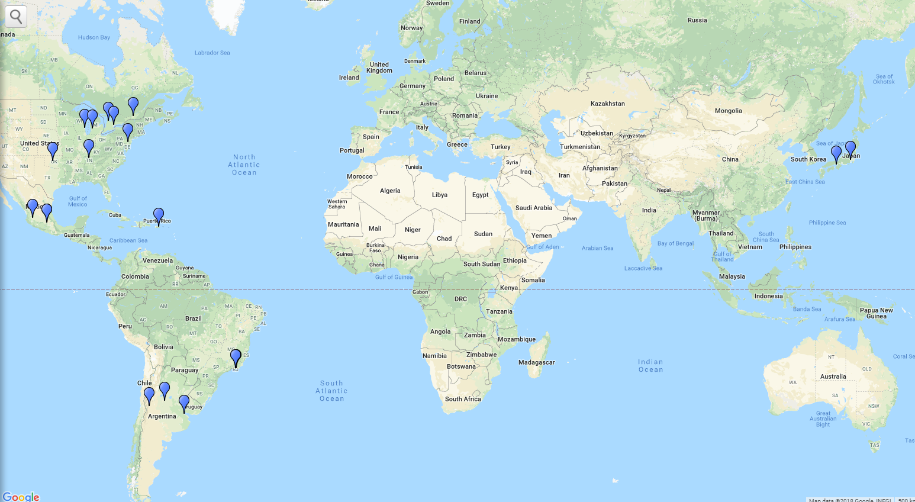


CA
4 ICUs
11 ICUs
UK
24 ICUs
EU & RUSSIA
9 ICUs
Asia
4 ICUs
6 ICUs
USA
9 ICUs
19 ICUs
LATAM
16 ICUs
7 ICUs
Middle E
3 ICUs
Australia &
New Zealand
2 ICUs
235 patients randomized to date
33 ICUs in 9 countries
33 Active ICUs
103 Queue ICUs
Notes:
Jen/Alfonso, update end of april

Slide 14


Study Status
150!
Significant delays in start up; long turn around time for contracts
103 Sites in the ‘queue’ that we know of
Notes:
Jen/Alfonso, update end of april

Slide 15
Study Status
Notes:
Danni, in your slide #10, please explain the consent situation

Slide 16
EFFORT Barriers Survey Results – US only
Demographic | Overall (n=106) | USA (n=61)
Female | 86 (81) | 45 (85)
Male | 20 (19) | 8 (15)
Age (years) | 45 | 46
min | 24 | 24
max | 72 | 69
Profession
Doctor | 27 (26) | 13 (24)
Dietitian | 66 (63) | 32 (59)
Pharmacist | 2 (1) | 1 (2)
Nurse | 10 (10) | 8 (14)
Years of experience | 16 | 17
min | 0 | 1
max | 45 | 45
Type of Hospital
Non-Teaching | 22 (20) | 11 (18)
Teaching | 84 (80) | 50 (82)
Open/closed ICU
Open | 28 (26) | 18 (29)
Closed | 72 (68) | 36 (59)
Other | 6 (6) | 7 (11)
# ICU beds | 30 | 29
min | 3 | 6
max | 240 | 90
Dietitian working in the ICU
Yes | 94 (88) | 61 (100)
FTE | 1.1 | 1.23
min | 0.25 | 0.2
max | 7 | 7
User Language
English | -- | 55 (90)
Spanish | -- | 6 (10)

Slide 17
To what extent do you understand the...

Slide 18
To what extent do you agree with……
Notes:
Note to self: Major barrier is the unacceptability of 1.2- need to hammer home equipoise (negative studies), what else?

Slide 19
How confident are you that today you could….
Notes:
Note to self: engaging and apply and workload major issues (will say more about work load later)

Slide 20

In the UK, what are barriers to engaging in EFFORT Trial?

Slide 21
Discussion Points
What can we do to increase the number of sites engaged?
What can we do to increase the number of patients enrolled?
What can we do to increase the ‘separation’ between the 2 groups?
Operational issues

Slide 22
Study Status
4000
Average 4 patients screened/2 randomized per unit per month
Notes:
Jen/Alfonso, update end of april

Slide 23
Eligible But Not Randomized
Notes:
Jen/Alfonso, update end of april

Slide 24
Study Status
Notes:
Jen/Alfonso, update end of april

Slide 25
Study Status
Losing a lot of otherwise patients because of lack of equipoise!
Notes:
Jen/Alfonso, update end of april
Note to self: Explore issues with high BMI and surgical patients

Slide 26
Consent failures
Consent Failure Rate: 32%

Slide 27
Does Clinical Equipoise Exist?

Slide 28
You have to have clinical equipoise (uncertainty) to be able to participate in this trial!
Similar paper ‘in press’ at NCP

Slide 29
FAQ re: Study Population
“What is the recommended dose for patients with renal failure receiving RRT?”
“Protein prescription in amounts of ≤ 1.2/kg/day is not rational in some groups of patients such as polytrauma, massive surgery and some burns. Will patients with higher protein needs be excluded from the study?”
ANS: There is no RCT level of evidence to support this guideline assertion and with the mounting evidence that protein may be harmful and suppress autophagy, we lack certainty that this is the right thing to do. We wish all these patients to be included in the RCT and plan an a priori specified subgroup analysis to evaluate the effect of protein dose on outcome in these specific subgroups.

Slide 30
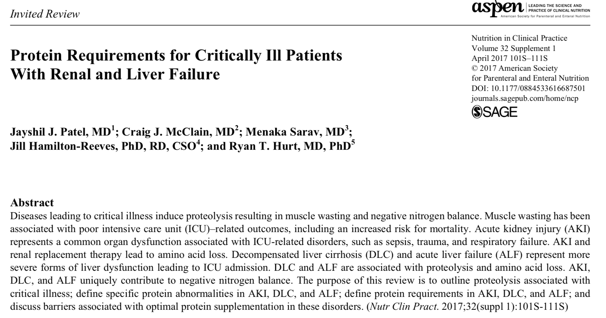

Slide 31
Protein dose in contemporary nutrition RCTs
Study, year | N | Intervention vs control | Intervention, protein target | Control, protein target | Intervention, protein delivered | Control, protein delivered
OMEGA, 2011 | 200 | Trophic vs full EN | 1.2-1.6 g/kg/d PBW | 1.2-1.6 g/kg/d PBW | 0.13 g/kg/d | 0.65 g/kg/d
EPaNIC, 2011 | 4640 | Early vs late SPN | Not reported | Not reported | 0.6 g/kg/d IBW¹ | 0.18 g/kg/d IBW¹
SPN, 2012 | 305 | EN + SPN vs EN | 1.2 g/kg/d IBW | 1.2 g/kg/d IBW | 1.2 g/kg/d | 0.8 g/kg/d
EDEN, 2012 | 1000 | Trophic vs full EN | 1.2-1.6 g/kg/d IBW | 1.2-1.6 g/kg/d IBW | Not reported³ | Not reported³
Early PN, 2013 | 1372 | Early PN vs standard practice | 1-1.5 g/kg/d ABW | Per local practice | 50%² | 30%²
CALORIES, 2014 | 2400 | Early EN vs PN | Per local practice | Per local practice | 0.7 g/kg/d | 0.6 g/kg/d
FERRIE, 2015 | 119 | High vs low protein using PN | 1.2 g/kg/d ABW | 0.8 g/kg/d ABW | 1.09 g/kg/d | 0.9 g/kg/d
NEPHRO, 2015 | 471 | High vs low protein using PN | 2.0 g/kg/d IBW | Per local practice | 1.6-1.7 g/kg/d | 0.6-0.7 g/kg/d
PERMIT, 2016 | 894 | 40-60% vs full calorie EN | 1.2-1.5 g/kg/d ABW | 1.2-1.5 g/kg/d ABW | 60-70%² | 60-70%²
TOP-UP, 2017 | 120 | EN+SPN vs EN | 1.2 g/kg/d ABW or IBW* | 1.2 g/kg/d ABW or IBW* | 95%² | 60%²
EAT-ICU, 2017 | 199 | EN + SPN (EGDN) vs EN | 1.63 g/kg/d^ | 1.16 g/kg/d^ | 1.47 g/kg/d | 0.5 g/kg/d
NUTRIREA-2, 2018 | 2410 | Early EN vs PN | Per local practice | Per local practice | 0.7 g/kg/d ABW⁴ | 0.8 g/kg/d ABW⁴
TARGET, 2018 | 3957 | Calorie dense vs standard EN | 1.4 g/kg/d IBW | 1.4 g/kg/d IBW | 1.1 g/kg/d | 1.08 g/kg/d

Slide 32
Subgroup Analyses
Age (based on median)
Severity of illness (based on median APACHE II)
Case Mix
  Sepsis
  Trauma
  Surgical
  AKI and/or RRT at baseline
  Liver Disease
Malnutrition risk factors, both individually and combinations
  BMI, Nutric, frailty, sarcopenia, traditional risk factors
Wounds
Others?

Slide 33
Subgroup of Patients
Subgroup | n= 93
Obesity (BMI >30) | 39 (35.8%)
Acute kidney injury/renal failure / Renal diseases | 23 (21.1%)
Patients with sepsis | 20 (18.3 %)
Surgical Patients | 7 (7%)
Poly trauma | 6 (5.5%)
Older patients (>80 years) | 5 (4.6%)
Liver disease | 0

Slide 34
What more can we do to convince you that your are not harming patients by prescribing 1.2 grams/kg/day?

Slide 35
FAQ re: Workload?!!
Some sites are worried that they may actually have too many patients eligible to randomize and end up with more work than they can feasibly take on with a study with no funding.
Workload is driven by 4 components
Start up activities- it is what is, Jen Korol can help?
Screening and enrollment- We are okay with sites intermittently screening (periods of the week that they are actively screening and other periods which they are not) vs. screening daily to enroll consecutive patients.
Monitoring daily protein adequacy- we have seen that some busy sites have not been able to monitor nutritional adequacy sufficiently because they have more than one patient on study and are too busy. A caution against enrolling too many patients too fast. You need to ensure the quality of protein intake daily of your patients.
Data collection and query resolution (read the manuals)
Notes:
Note to self: Take the long view, 30 patients over 3 years

Slide 36
Discussion Points
What can we do to increase the number of sites engaged?
What can we do to increase the number of patients enrolled?
What can we do to increase the ‘separation’ between the 2 groups?
Operational issues

Slide 37
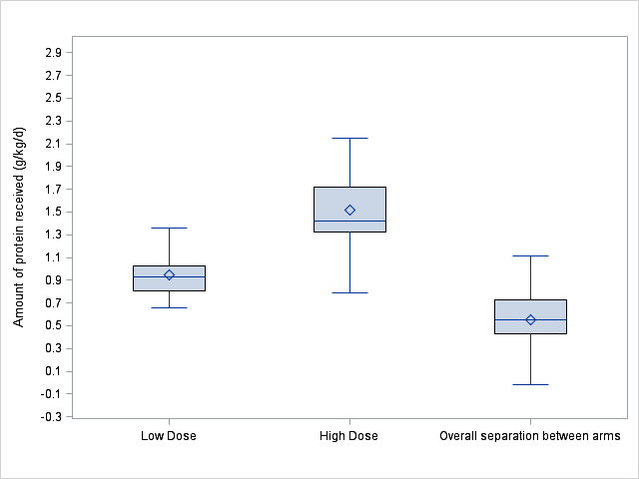
Overall Separation of Groups (n=83)

Slide 38
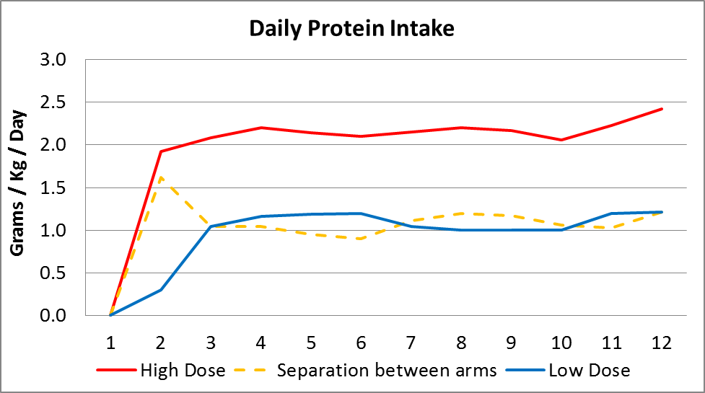
Best Site
Hospital Civil Fray Antonio Alcalde, Guadalajara, Mexico
(using PEP uP Protocol)

Slide 39
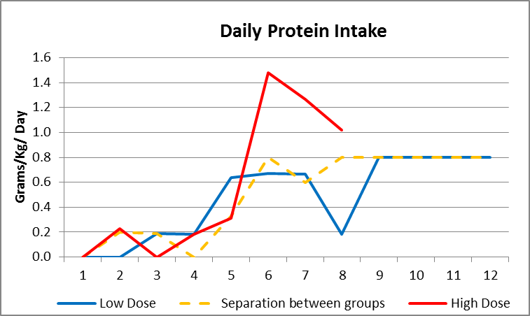
Site with low compliance

Slide 40
Early & Remote Evaluation/Support
Screening/enrolling
Barriers
Clinical Equipoise in the ICU team
First 12 evaluable nutrition days only
FAQs
Touch
base
Second Touch Base
Central Monitoring
Periodic source verification
Site with min 4 patients
(2 in high dose group)
Site Benchmark Reports
Data Quality
Query resolution

Slide 41
FAQ re: Intervention
“How do I achieve the higher doses of protein? Is their a particularly product or strategy you are recommending?”
ANS: No. this is a pragmatic trial in which the only thing that you are constrained to do is prescribe a high or usual amount of protein. There is prescribed way achieve the high protein intake. You can use all products, protocols and strategies available to you.
Note: you should get involved in this trial if you don’t have products or protocols that guarantee that you can achieve near goal in the high group.

Slide 42
How do I achieve the high protein intake?
High protein containing EN solutions
EN protein supplements
PN
Parenteral amino acids (if available)
Or combinations of the above!

Slide 43

The PEP uP Protocol!
The Efficacy of Enhanced Protein-Energy Provision via
the Enteral Route in Critically Ill Patients:
Different feeding options based on hemodynamic stability and suitability for high volume intragastric feeds.
In select patients, we start the EN immediately at goal rate, not at 25 mL/hr.
We target a 24 hour volume of EN rather than an hourly rate and provide the nurse with the latitude to increase the hourly rate to make up the 24 hour volume.
Start with a very high protein solution; semi elemental solution then progress to polymeric
Motility agents and protein supplements are started immediately, rather than started when there is a problem
Tolerate higher GRV threshold (300 mL or more)
A Major Paradigm Shift in How we Feed Enterally
Heyland Crit Care 2010
see www.criticalcarenutrition.com for more information on PEP uP tools

Slide 44
Use of High Protein Containing Enteral Solutions
Van Zanten Crit Care 2018

Slide 45
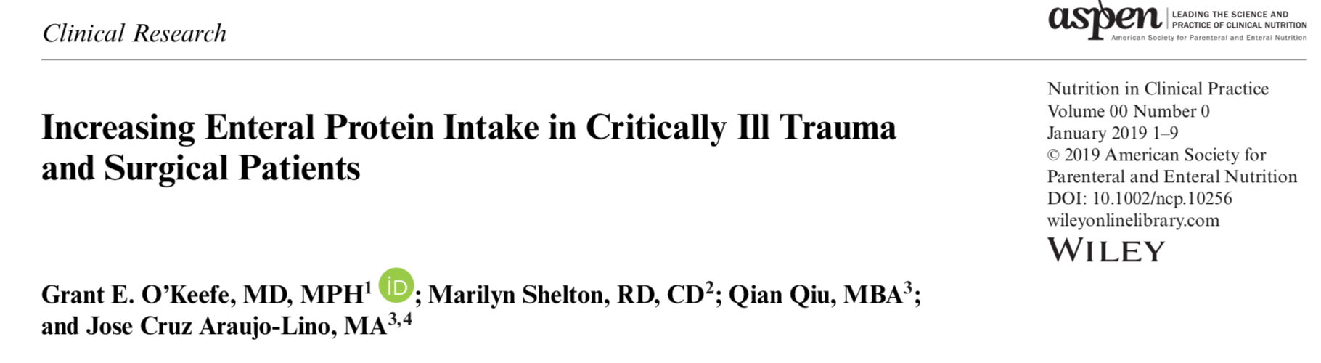
53 trauma patients receiving EN plus protein
supplements
routinely
O Keefe, NCP Jan 2019
Notes:
Note to self: Have grant present- waiting for this slides. Will swap out this slide for his slides
Charlene to work with aspen to Promote companies and their products

Slide 46
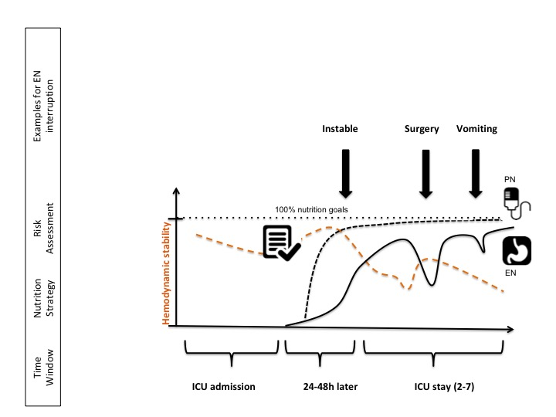
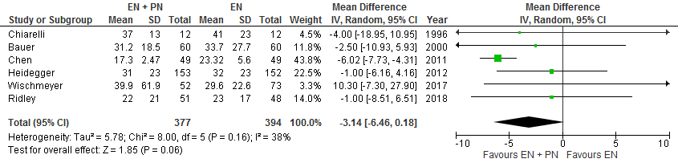
Meeting Nutritional Targets of Critically Ill Patients by Combined Enteral and Parenteral Nutrition:
Meta-analysis and the EFFORT-combo trial
No effect on mortality with the use of combination EN+PN (RR 1.00, 95% CI 0.70, 1.41, p=0.98, heterogeneity I²=41%).
Near significant reduction in hospital stay
Treatment effect may be greater in nutritionally-high risk patients
Hill, Stoppe, Heyland “in submission”

Slide 47
The Nephroprotect Study
EN plus IV amino acids vs. EN alone
Doig Int Care Med 2015

Slide 48
The Nephroprotect Study
P=0.004
Confirms Safety of this approach
May be greater treatment effect in
‘nutritionally-high risk patients’
No difference in any other renal or clinical outcome
No impact on survival or HRQOL
Doig Int Care Med 2015

Slide 49
FAQ re: Intervention
What happens if an enrolled patient does not meet 80% of their protein prescription over their ICU stay?
No penalty if patient doesn’t reach the protein goal or 80% each day, however, we expect that sites, based on their clinical experience, be able to provide the protein goal to patients allocated to each arm of study.
We have built in a daily nutritional adequacy tool into REDCap to help sites monitor their adherence to the study intervention and nutrition goals. This tool will allow you to clearly see how well you are complying with the treatment protocol and make changes to improve your adherence.

Slide 50
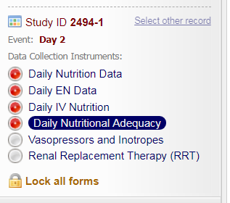
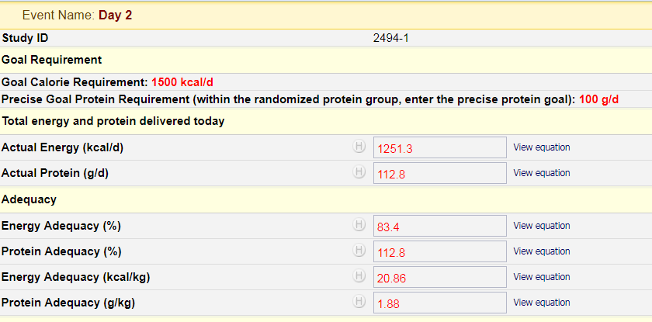
Daily Monitoring
REDCap tool for daily protein and
caloric adequacy monitoring

Slide 51
Discussion Points
What can we do to increase the number of sites engaged?
What can we do to increase the number of patients enrolled?
What can we do to increase the ‘separation’ between the 2 groups?
Operational issues

Slide 52
Tips and Tricks 101
Avoiding Queries
Day 1 is ICU Admit date NOT Randomization date
Pay attention to the units you enter for CR; Urea; Glucose etc. i.e. mmol/L or mg/dL or umol/L
Pay attention to the units that are prescribed by REDCap.
  Height in meters not centimeters;
  Vasopressin units/minute not units/hour.
Query resolution should be done when you believe data entry is complete. As partially completed forms will result in multiple missing queries for all the data that wasn’t completed yet.
Avoid using the ‘OTHER’ field when there is an applicable option available.
SPM & Query manuals are excellent resources found on the CCN website!

Slide 53
The Effect of Higher Protein Dosing in Critically Ill Patients: A Multicenter Registry-based Randomized Trial
EFFORT US sub study
Outcomes
Ultrasound of quadriceps (only addition to parent trial)
  Muscle Linear Depth (LD)
  Cross sectional Area (CSA)
  Echogenicity
  Pennation angle
  fascicle length
  Baseline, day 10 and hospital DC
60 day mortality; TTDA, LOS, other clinical outcomes
Higher protein dose
(>2.2g/kg/day)
500
nutritionally high risk ICU patients
R
Usual protein dose
(< 1.2 g/kg/day)

Slide 54
The Effect of High Protein and Low Protein, Clinical Outcomes, Functional Outcomes and Quality of Life in Mechanically Ventilated Critically ill Patients (The EFFORT-Outcomes)
Outcomes
6 Min Walk Test (primary)
MRC Sum-score
Handgrip Dynamometry
Hand Held Dynamometry
Short Physical Performance Battery
Discharge location
FSS ICU
Ultrasound of quadriceps
Abdominal CT
Bio-electrical impedance analysis (BIA)
SF-36
EQ5D5L
Katz ADL
Lawton IADL
Higher protein dose
(> 2.2g/kg/day)
142
nutritionally high risk ICU patients
R
Usual protein dose
(> 1.2 g/kg/d)

Slide 55
The Effect of High Protein and Early Resistance Exercise versus Low Protein and Usual Exercise Care on Muscle Mass, Strength and Quality, Clinical Outcomes, Functional Outcomes and Quality of Life in Mechanically Ventilated Critically ill Patients (The EFFORT-X Trial)
Outcomes
Ultrasound of quadriceps (Primary)
6 Min Walk Test
MRC Sum-score
Handgrip Dynamometry
Hand Held Dynamometry
Short Physical Performance Battery
Discharge location
FSS ICU
Abdominal CT
Bio-electrical impedance analysis (BIA)
SF-36
EQ5D5L
Katz ADL
Lawton IADL
Higher protein dose (>2.2g/kg/day)
+Cycling
120
nutritionally high risk ICU patients
R
Usual protein dose
(< 1.2 g/kg/d)

Slide 56
The Effect of High Protein and Dosing in Critically Ill Patients: A multicenter Randomized Trial
(The EFFORT-Combo)
EN + PN
Higher protein dose
(>2.2g/kg/day)
Outcomes
6 Min Walk Test (Primary)
MRC Sum-score
Handgrip Dynamometry
Hand Held Dynamometry
Short Physical Performance Battery
Discharge location
FSS ICU
Ultrasound of quadriceps
Abdominal CT
Bio-electrical impedance analysis (BIA)
SF-36
EQ5D5L
Katz ADL
Lawton IADL
142
nutritionally high risk ICU patients
R
EN only Standard Care
Usual protein dose
(<1.2g/kg/day)

Slide 57
Other questions?

Slide 58
Next Steps

Slide 59

Thank YOU for your interest and support
I can not do what you can do.
You cannot do what I can do.
Together, we can do great things!
-Mother Theresa
For more information
See www.criticalcarenutrition.com or contact: Daren Heyland dkh2@queensu.ca
Project Leader : Jen Korol Jennifer.korol@kingstonhsc.ca

